Slide 1
Ride & Drive
Name : Dalip Kumar
Class : bca3rd
Roll no : 457

Slide 2
TABLE OF CONTENTS
01
02
03
INTRODUCTION
OBJECTIVES
MODULE

Slide 3
introduction
Introduction to the Project Car rental system is software program for car rents for travel-tour, cab operations and any other occasion for travel to manage day to operations. This project focus on cab & cars operator who have more than 20 cars & cabs in the city. Background This website is based on cars & cabs provides to ride for rent. We try to best service to provides for our customers.

Slide 4
Objective
• Designing framework for rental automobile procedure to digital method.
• Analysis of vehicle rental and validate using dynamic method using dynamic method.
• To purpose a web-based system that will help manage the business transaction

Slide 5
01
Designing
Create simple and normal patten for designing the fully website or this modules in using css html or color shades

Slide 6
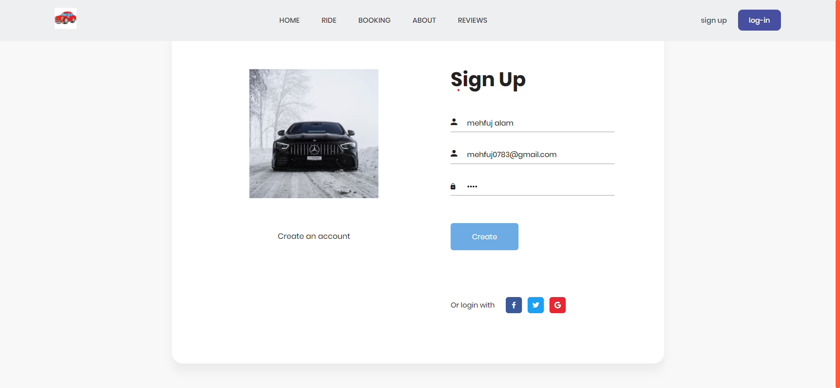
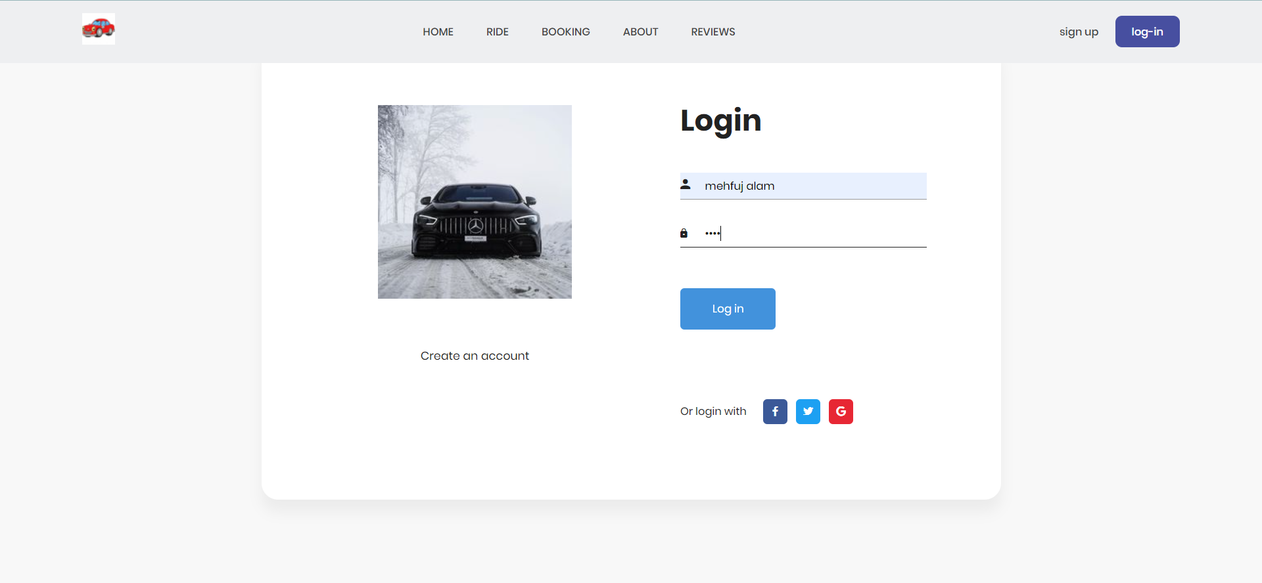
SIGN UP & LOGIN FORM

Slide 7
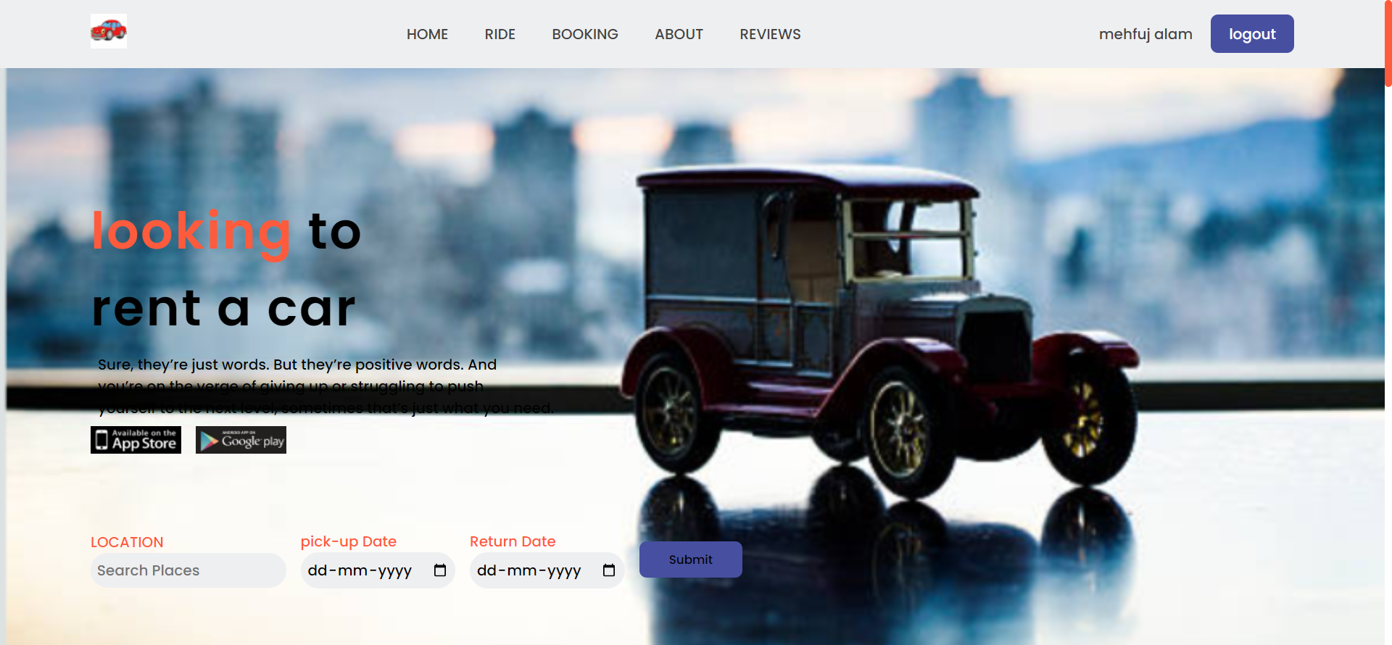

Slide 8
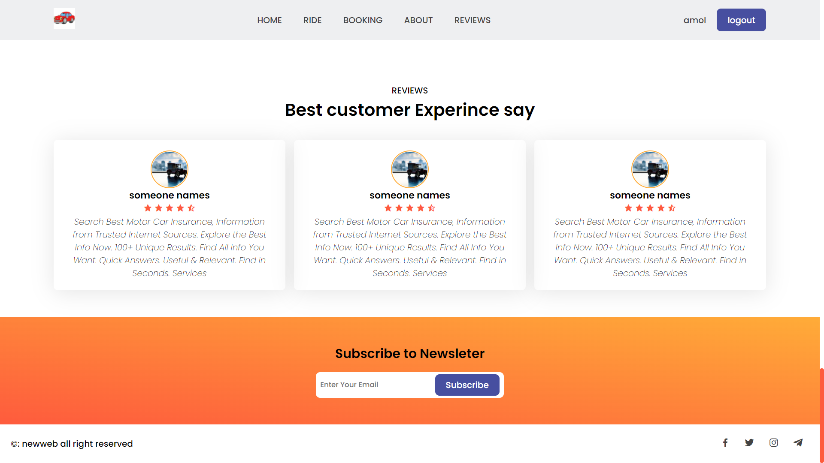

Slide 9
Fonts & colors used
This presentation has been made using the following fonts:
Oswald Semi-Bold
(https://fonts.googleapis.com/css2?family=Poppins:ital,wght@0,300;0,500;0,600;1,200&display=swap)
Lato Regular
(https://google color shdes.com)
#f6b26bff
#f1f1f1
#b4a7d6ff
#8e7cc3ff
#351c75ff
#20124dff

Slide 10
Thank you

